Slide 1
DSCP Project: calculate the flight ticket price
Haorui Wu, Will Wang, Xiangcheng Li, Xinrui Zhong, Yiming Zhang
Group 6

Slide 2
Experiment design
We get the Flight Price dataset from Kaggle, Flight Prices, to build models to predict the flight price from one airport to another
Separate into two groups, one data cleaning group and one group focus on parallel computing using CHTC

Slide 3
Data Cleaning
We downloaded the dataset from Kaggle and remove all the business/first class ticket price since there are few data about the ticket price of the business/first class, we don’t have enough data to support our result if we want to calculate that price.
We divide the whole big dataset by using the feature startingAirport and destinationAirport which can indicate where the passages’ origins and destinations
We divided each of the small dataset into two part using the variable isNonStop, this feature indicate if the flight contains a stop or not, which will also make a big influence on the ticket price.

Slide 4
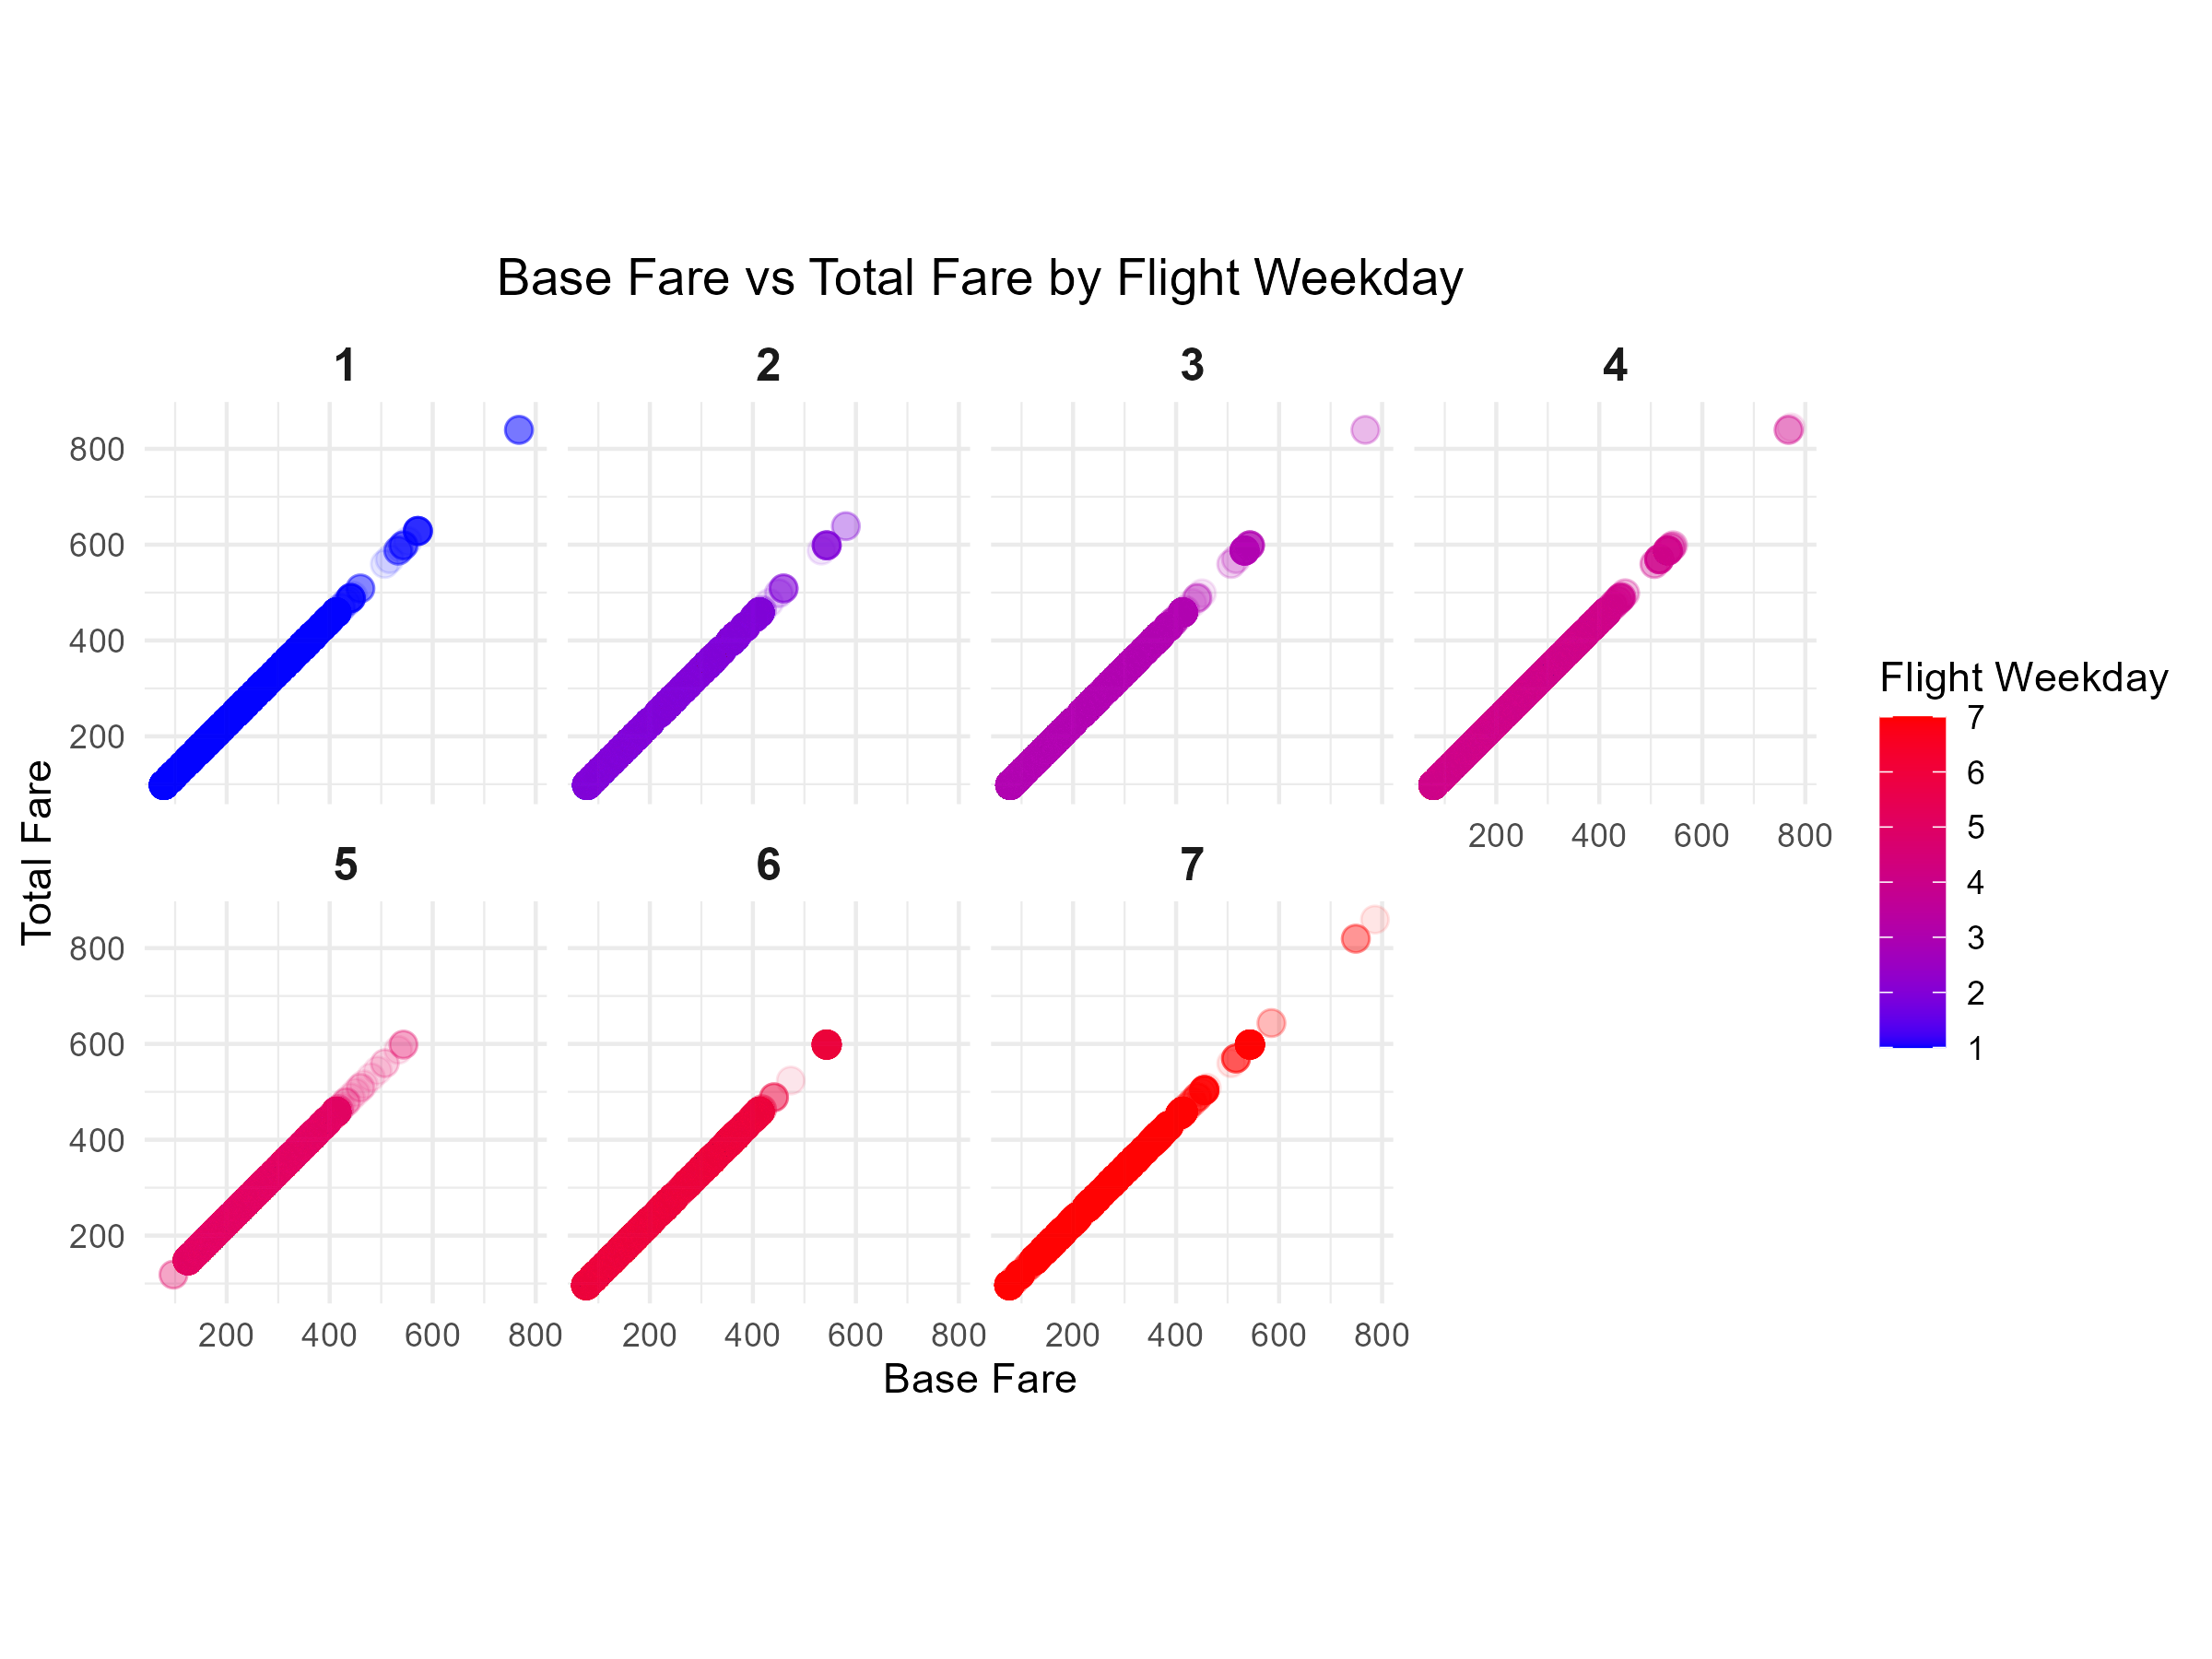
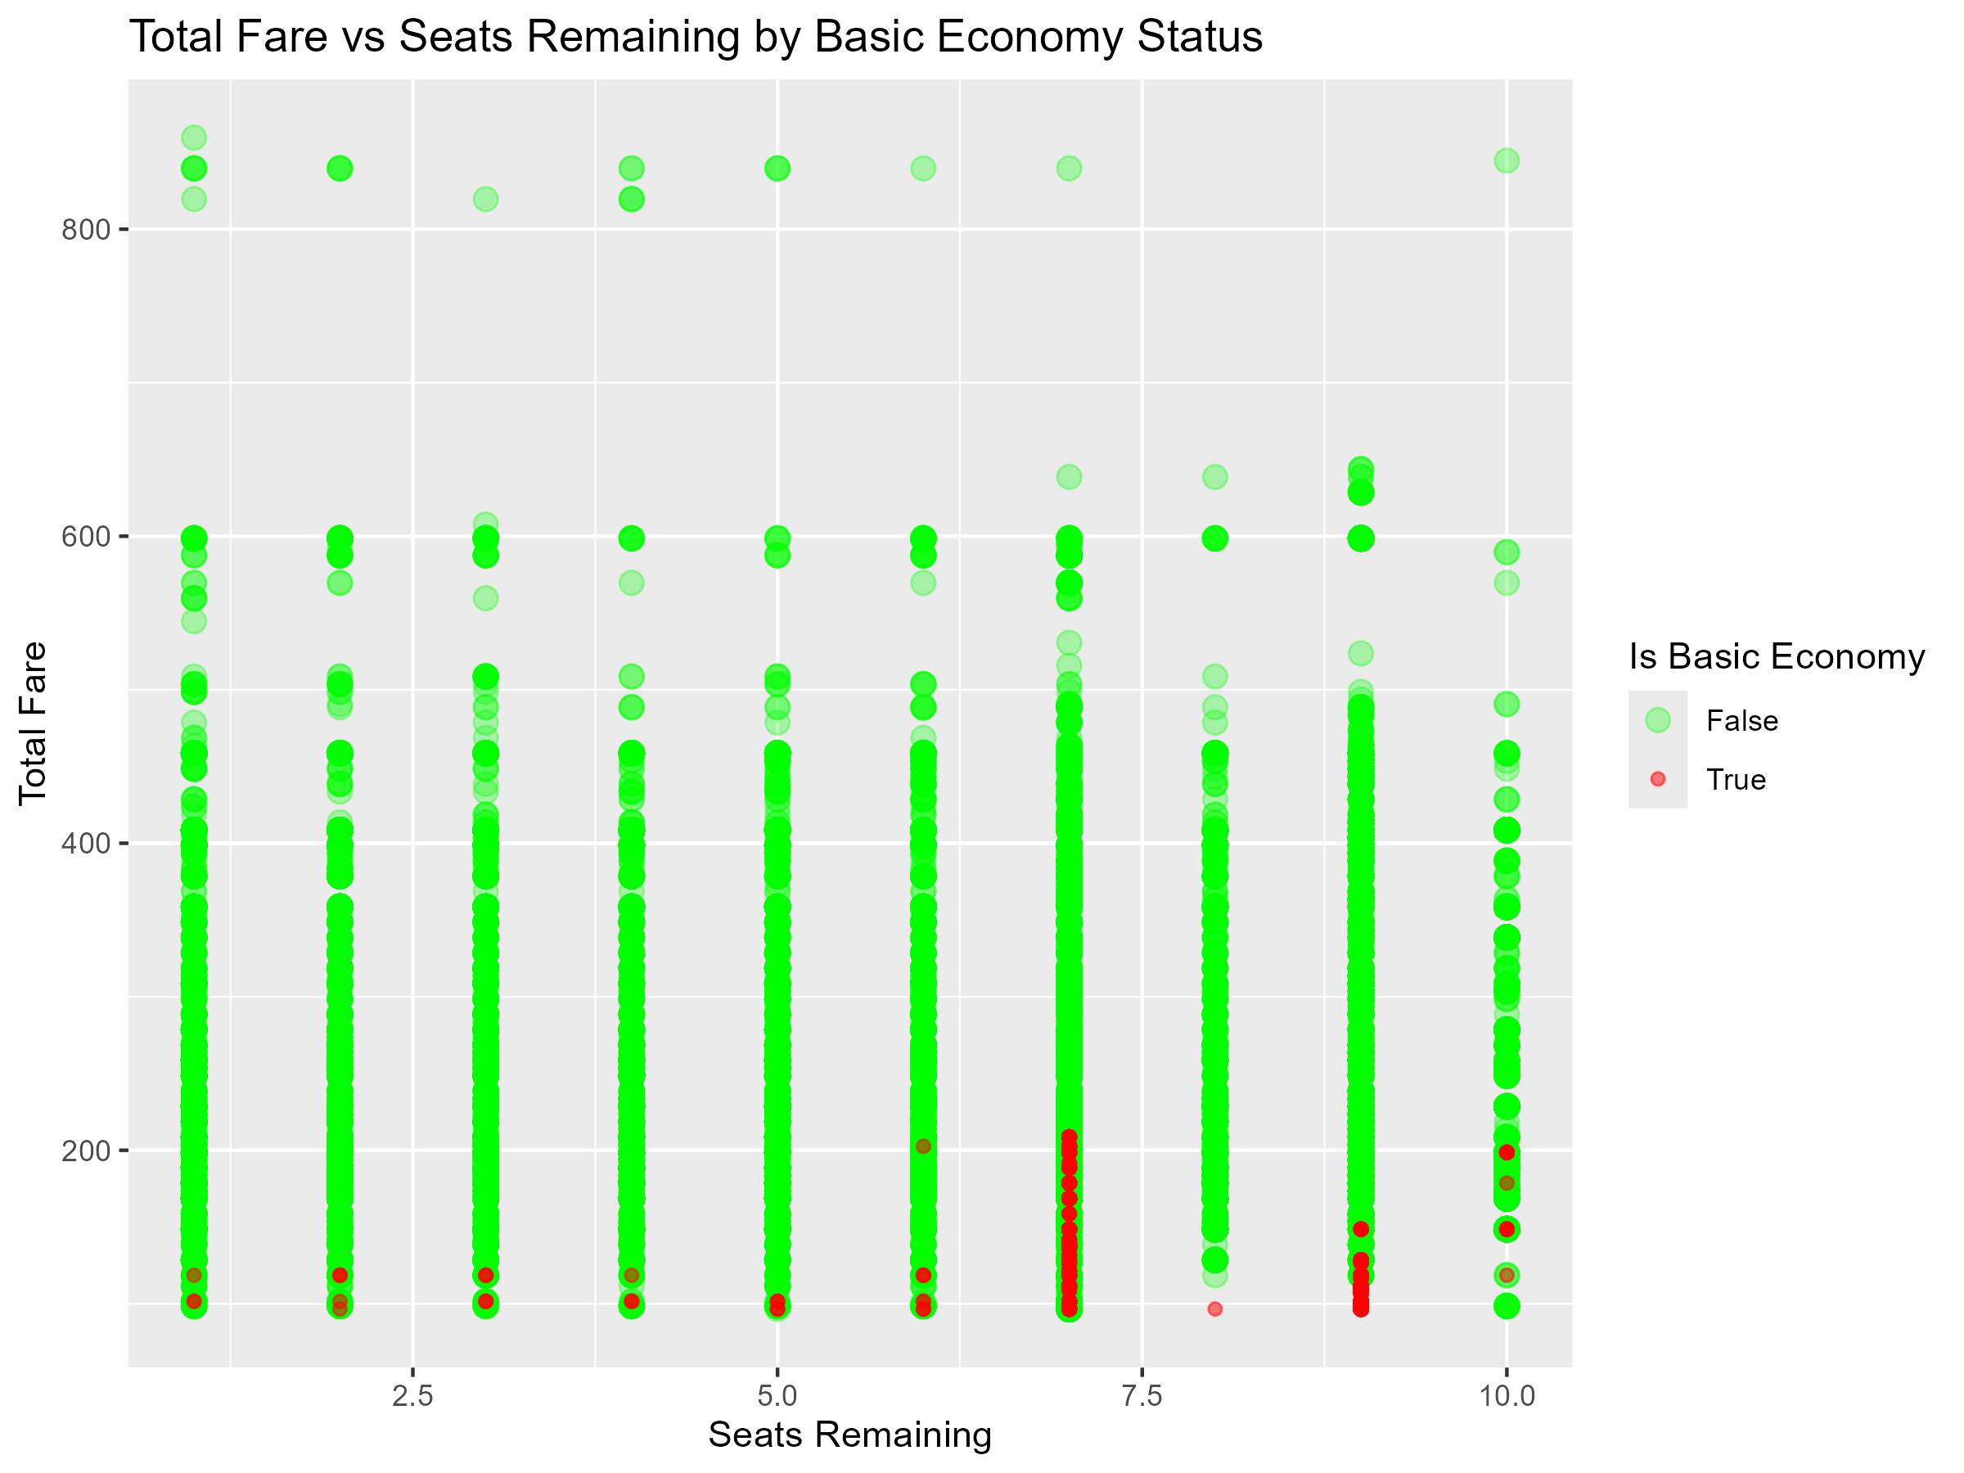
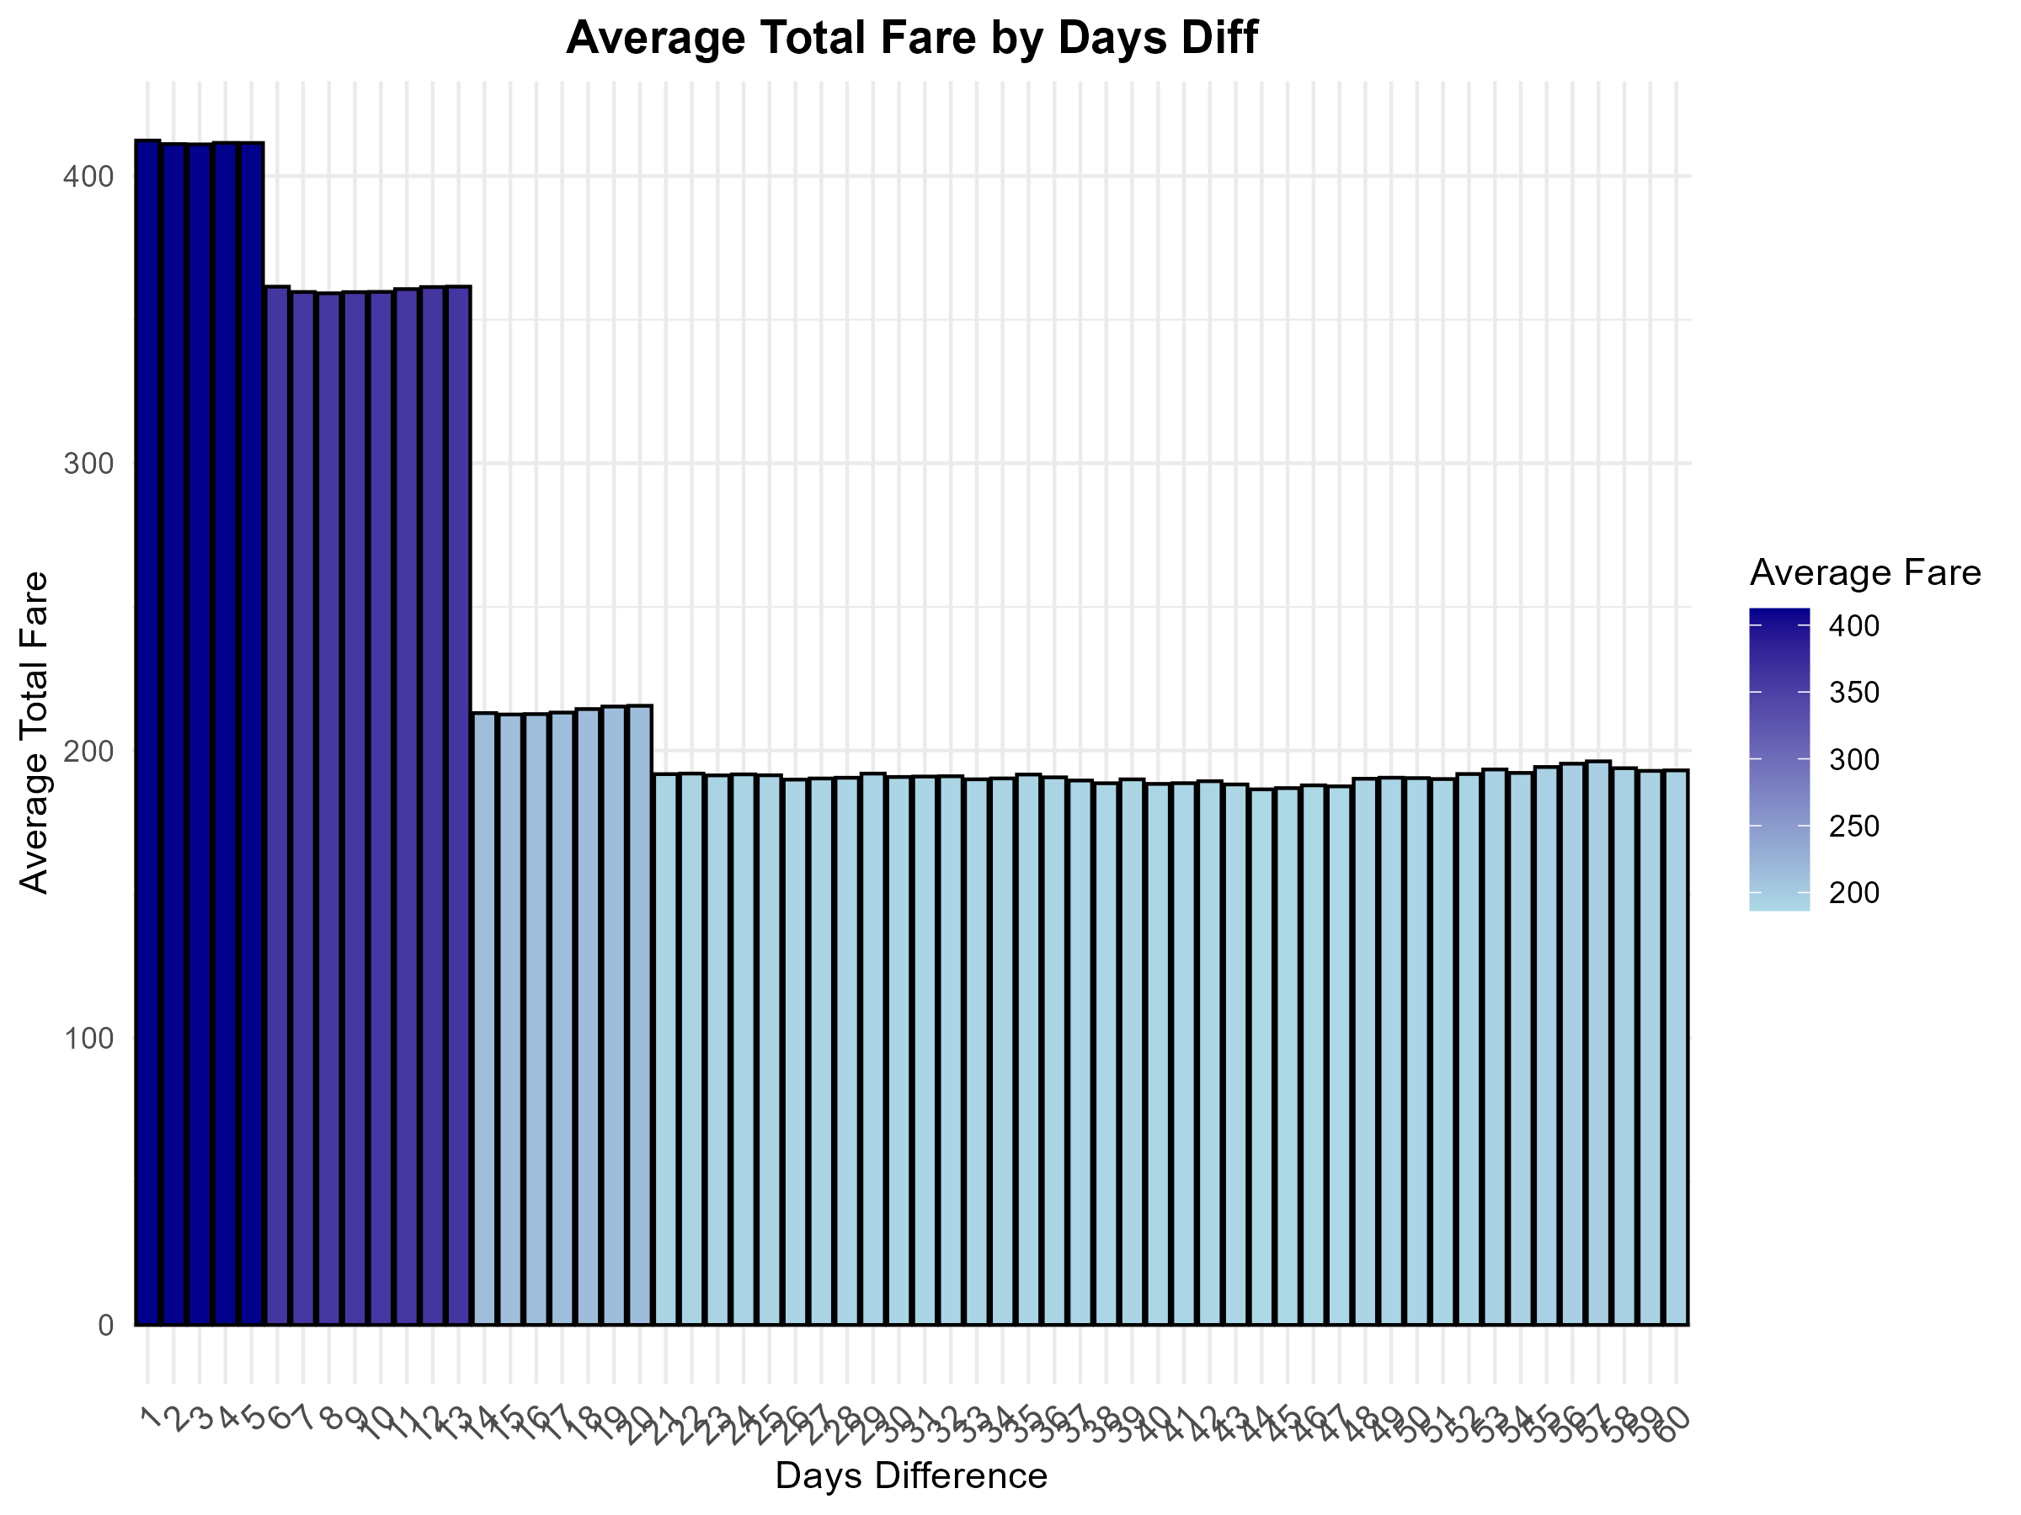
Data Visualization

Slide 5
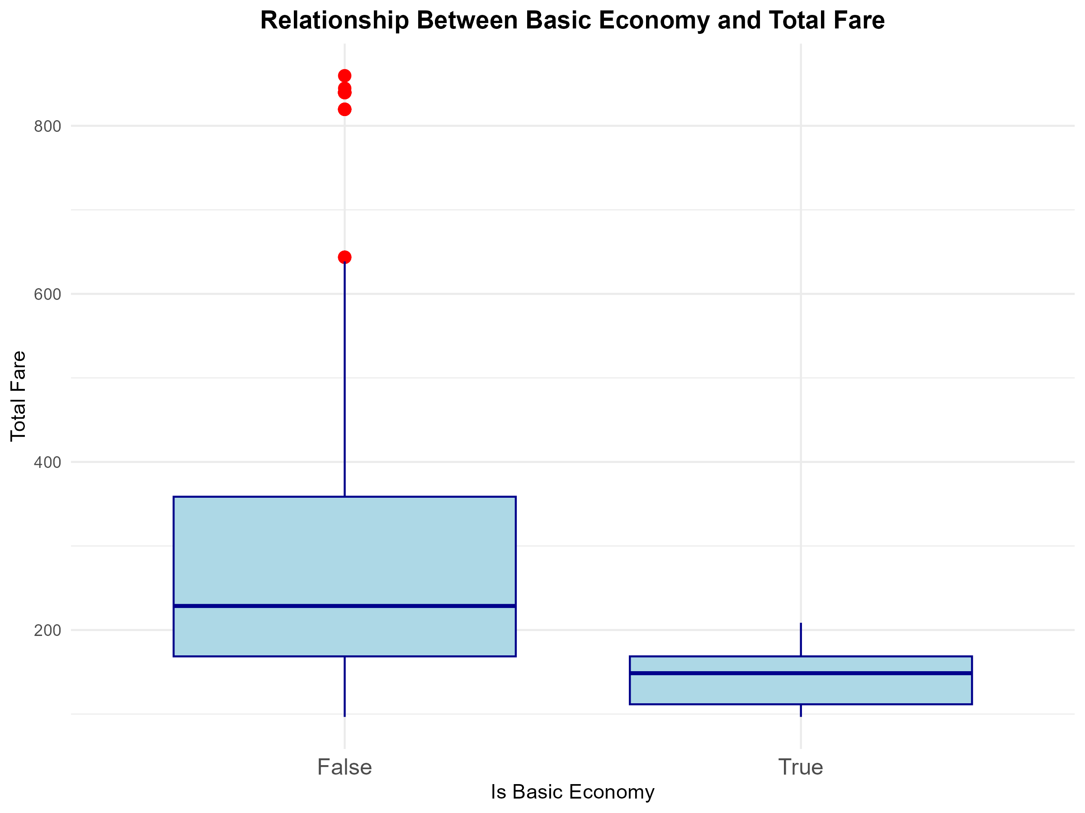
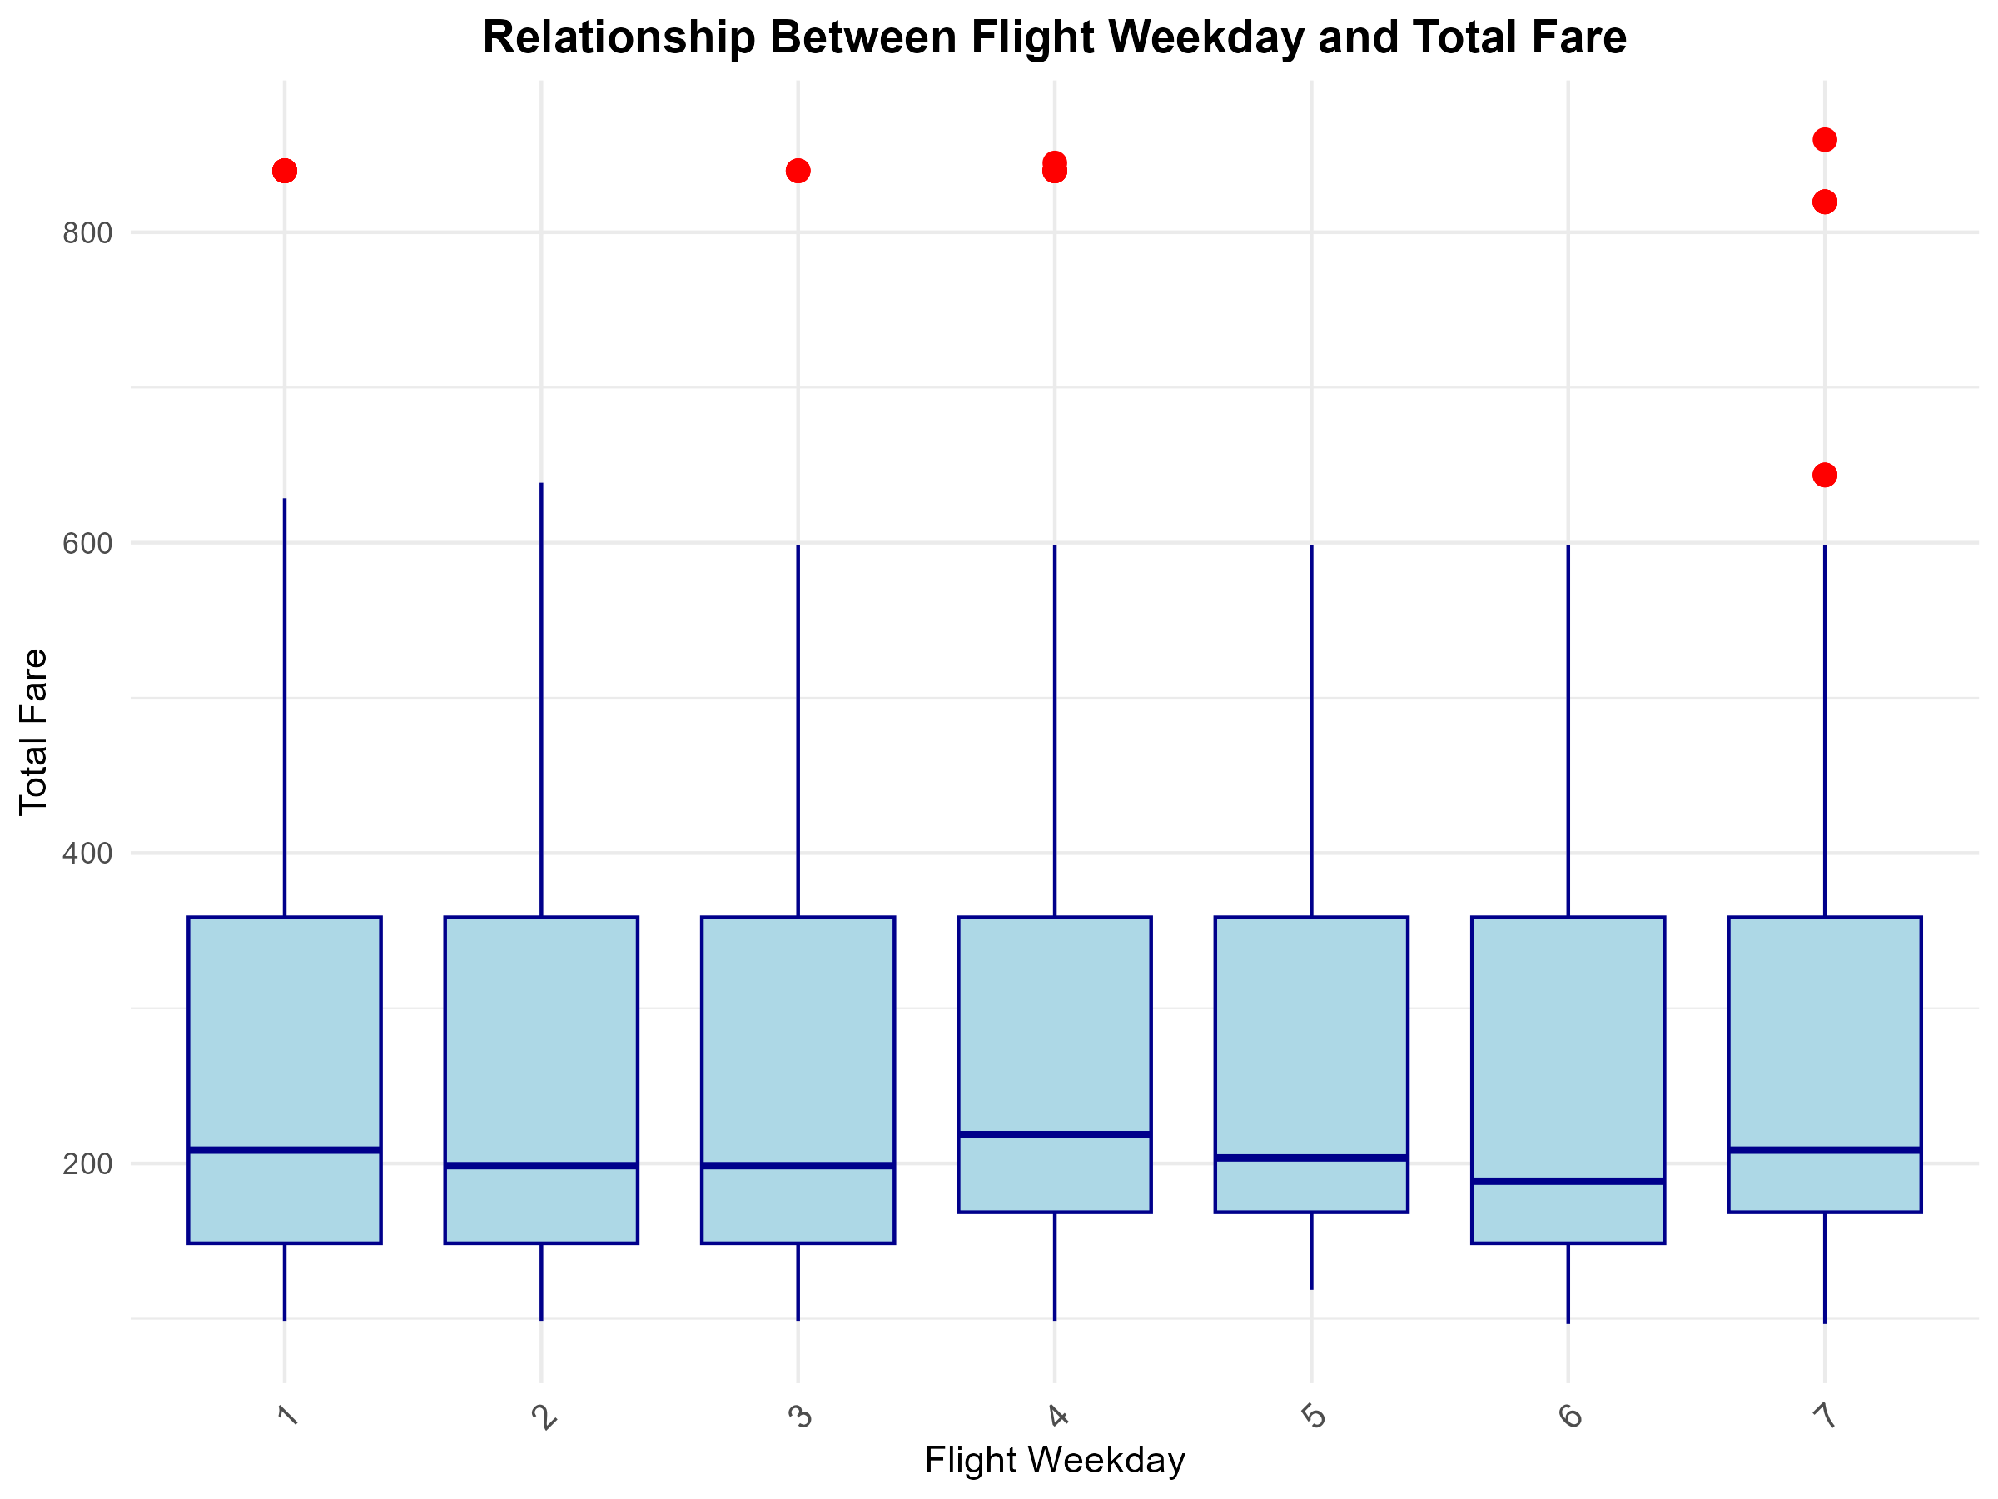
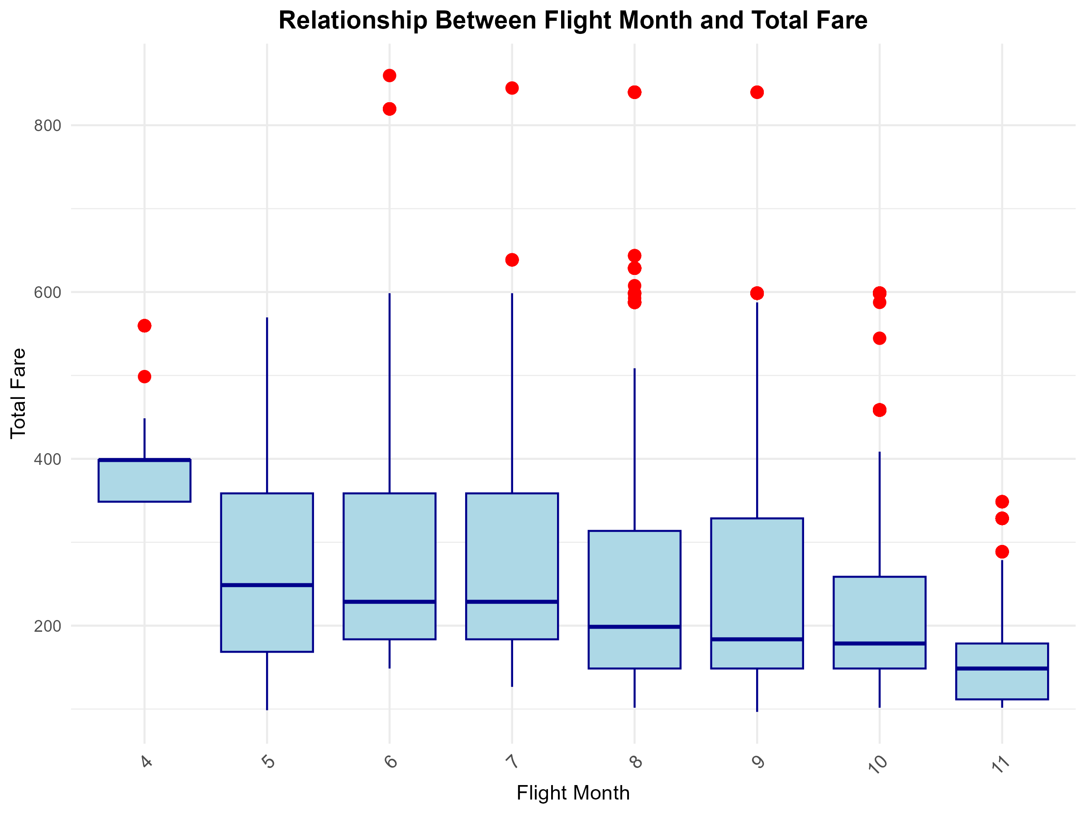
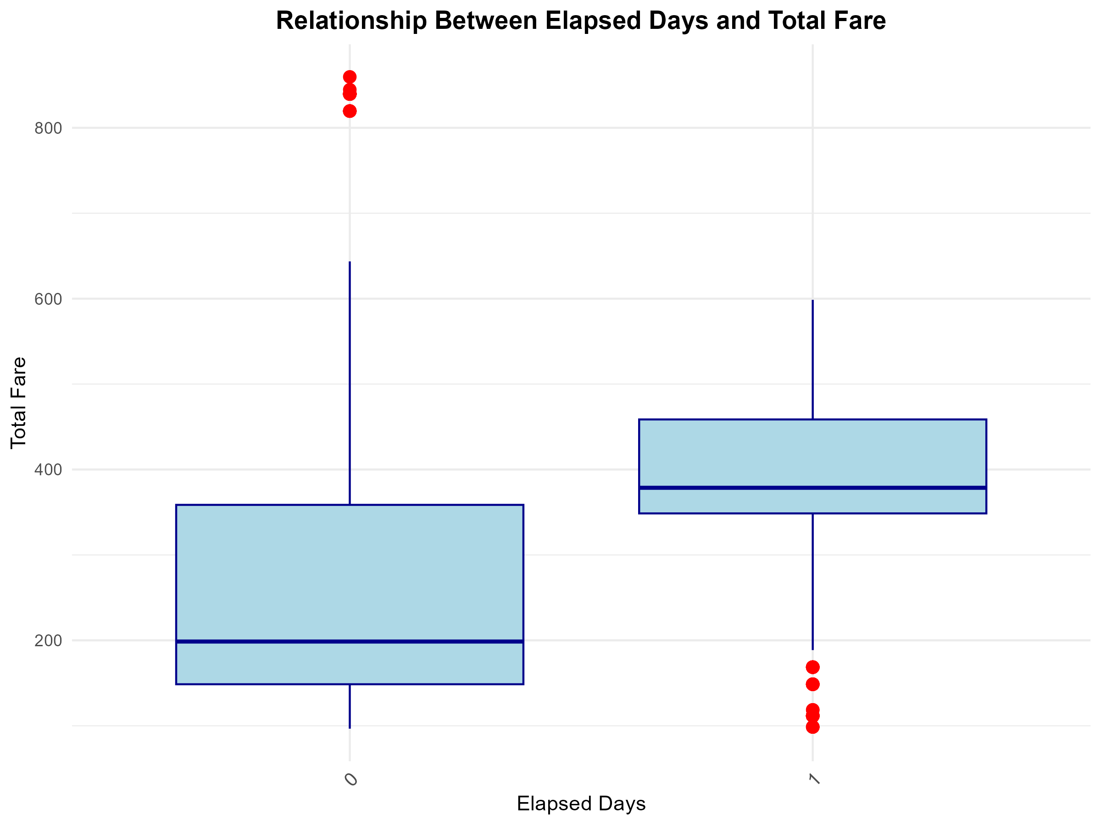

Slide 6
Parallel computing
model.sub
ATL_CLT_Nonstop.csv
model.sh
ATL_CLT_Nonstop.csv
model.R
ATL_CLT_Nonstop_rf_model.rds
prediction.sub
days_diff
weekday
prediction.sh
days_diff
month
prediction.R
predictions_days3_month6_weekday4_meanbase.csv
month
weekday
model.rds
model.rds

Slide 7
Model.R :Random forest model
Feature | Importance
baseFare | 119.1
flight_weekday | 30.9
seatsRemaining | 28.8
flight_month | 24.9
isBasicEconomy | 18.9
days_diff | 17.0
elapsedDays | 11.2

Slide 8
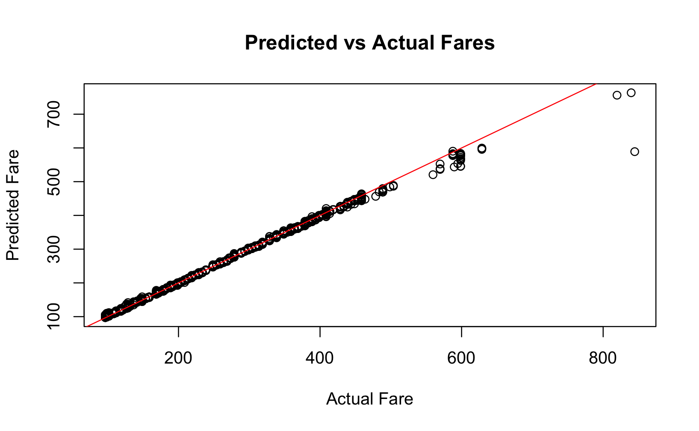
Random forest model

Slide 9
Outcome
Base Fare | Elapsed Days | IsBasic Economy | Is Refundable | Seats Remaining | Days Diff | Flight Month | Flight Weekday | Predicted Fare
84.5 | 0 | TRUE | FALSE | 9 | 3 | 6 | 4 | 148.9
76.3 | 0 | TRUE | FALSE | 8 | 3 | 6 | 4 | 149.3
212.2 | 1 | TRUE | FALSE | 10 | 3 | 6 | 4 | 159
191 | 0 | FALSE | FALSE | 1 | 3 | 6 | 4 | 225.5
318.3 | 1 | FALSE | FALSE | 4 | 3 | 6 | 4 | 376.5

